Slide 1


Project Plan
Internship @KPMG

Slide 2
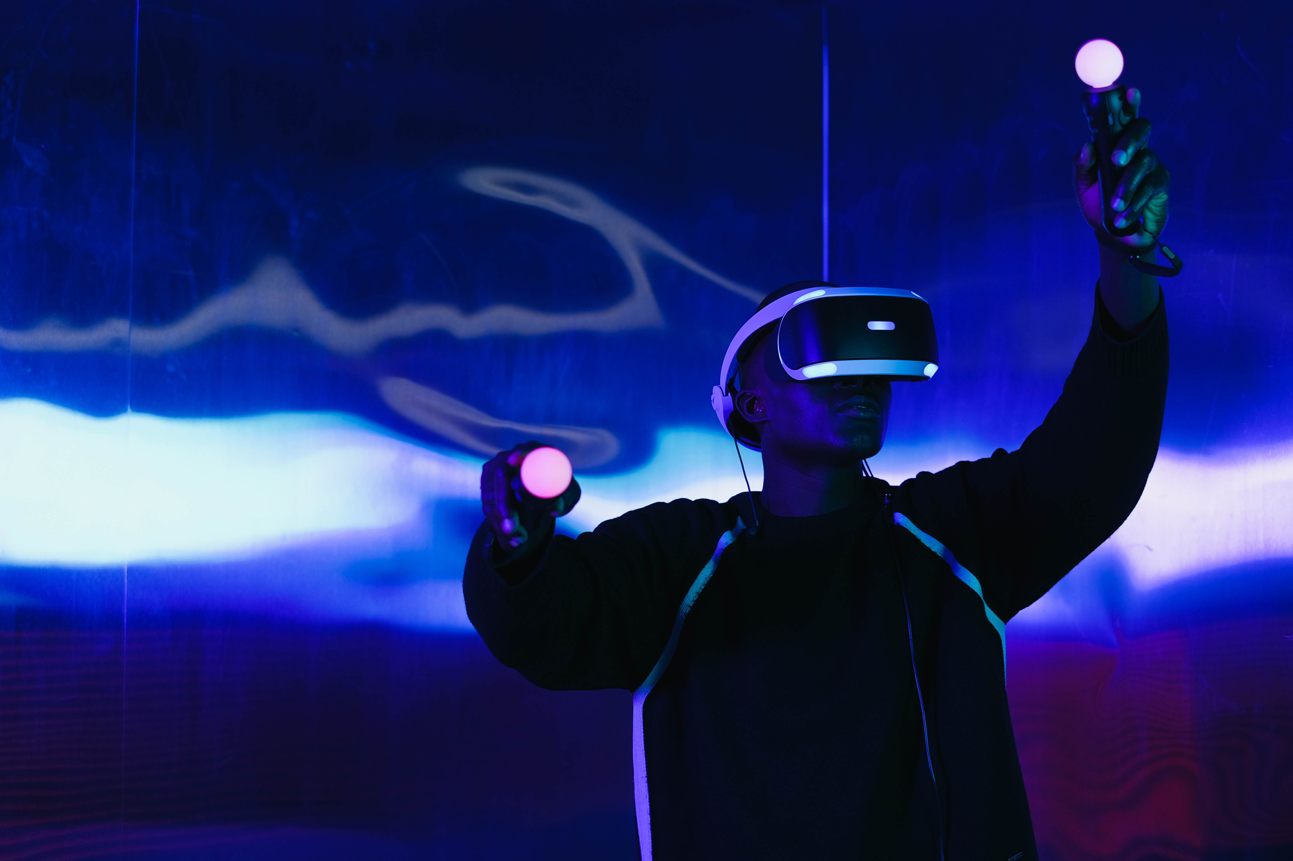
Content
01
Who
04
When
02
What
05
Communication
03
Why
06
Who is Who

Slide 3

WHO
KPMG Belgium
KPMG Belgium is part of KPMG’s global network, offering Audit, Tax, and Advisory services. They combine local expertise with international reach to help businesses—big and small—navigate financial, regulatory, and operational challenges.

Slide 4

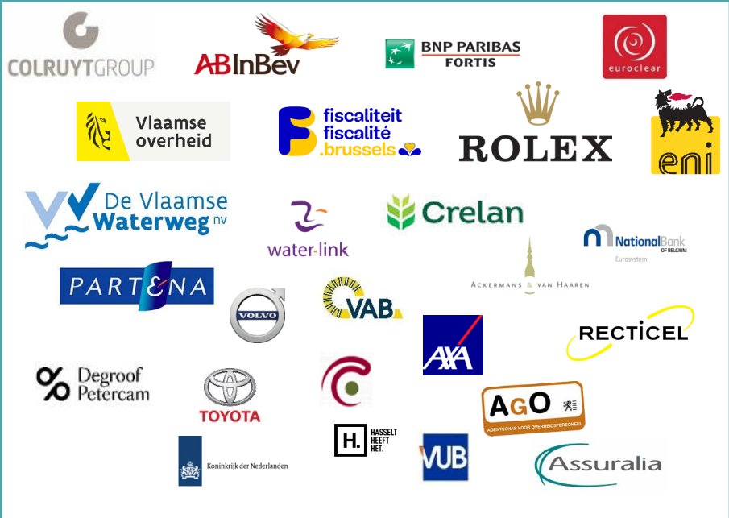

WHO
10 locals
Some Clients

Slide 5

WHO : KPMG Lighthouse
Data Strategy & Management
BI & Analytics
Advanced Analytics & AI
Intelligent Automation & NewTech
Digital Solution Architecture
Notes:
remove explanation

Slide 6

WHO : KPMG Lighthouse
Intelligent Automation
& NewTech
Implement Robotic Process Automation (RPA) and BPMN to streamline workflows.
Reduce manual tasks with cognitive automation and AI-driven tools.
Drive efficiency and innovation through next-generation technologies.

Slide 7
WHY ? & WHAT

Slide 8
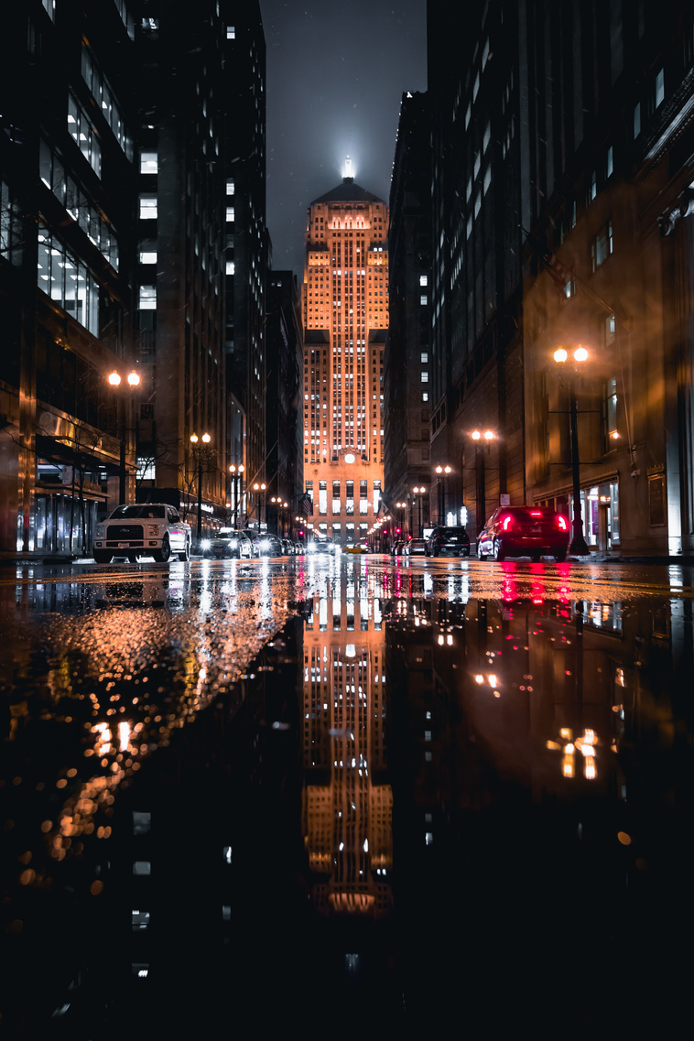
Notes:
Imagine it’s late at night. You have a critical presentation at 9 AM tomorrow, yet you’re still wrestling with slide layouts, bullet points, and endless formatting. Your key ideas are there…but the slides just don’t look or feel right. Sound familiar?

Slide 9


Notes:
Imagine it’s late at night. You have a critical presentation at 9 AM tomorrow, yet you’re still wrestling with slide layouts, bullet points, and endless formatting. Your key ideas are there…but the slides just don’t look or feel right. Sound familiar?

Slide 10

Notes:
Imagine it’s late at night. You have a critical presentation at 9 AM tomorrow, yet you’re still wrestling with slide layouts, bullet points, and endless formatting. Your key ideas are there…but the slides just don’t look or feel right. Sound familiar?

Slide 11

Notes:
Imagine it’s late at night. You have a critical presentation at 9 AM tomorrow, yet you’re still wrestling with slide layouts, bullet points, and endless formatting. Your key ideas are there…but the slides just don’t look or feel right. Sound familiar?

Slide 12




TIME SPENT
75%
The average professional spends up to 1-3 hours preparing and designing a single slide deck(around 10 pages)
Source : Quora
IMPACT ON PRODUCTIVITY
25%
Many teams report having to redo slides multiple times, wasting both time and energy.
leading to drop in productivity

Slide 13
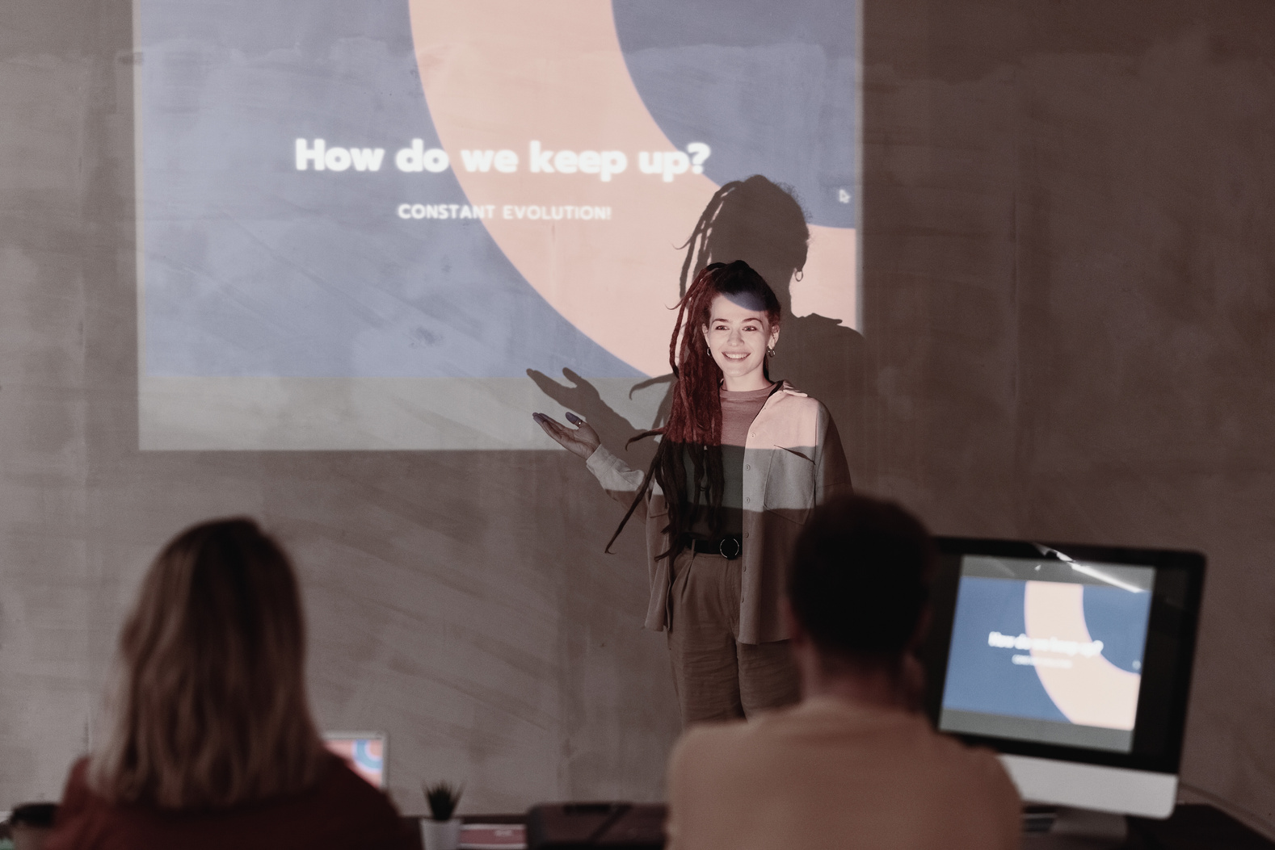
SLIDE DECK GENERATOR
Our Slide Deck Generator frees you from tedious formatting tasks, so you can spend your energy on what truly matters: crafting compelling ideas and delivering them with confidence.
Our Slide Deck Generator was born out of a need for a fast, efficient way to create compelling presentations
Key Features: It comes with templates, automated layouts. All you have to do , upload a document and Input Client .
01
Automatically finds and organizes the right information (RAG)

Slide 14






SLIDE DECK GENERATOR
Time Savings:
Automatic layouts and designs free up hours of manual work.
Consistency
A uniform look and feel ensures brand alignment and professional quality.
Ease of Use
Simple steps to convert raw content into polished slides.
Notes:
Now, imagine having a tool that quickly transforms your ideas into visually appealing, coherent slides—saving time and energy for what really matters: refining your message and connecting with your audience

Slide 15




KEY TECHNOLOGIES

Slide 16

RISK CONTROL
Analyzes data to predict risks and provide mitigation recommendations
Enhance decision-making and compliance.
Automates the monitoring of financial controls to detect anomalies in real time
02
Strengthens internal audit processes and reduces human error by leveraging LLMs for dynamic rule interpretation and anomaly detection

Slide 17
KEY TECHNOLOGIES

Slide 18


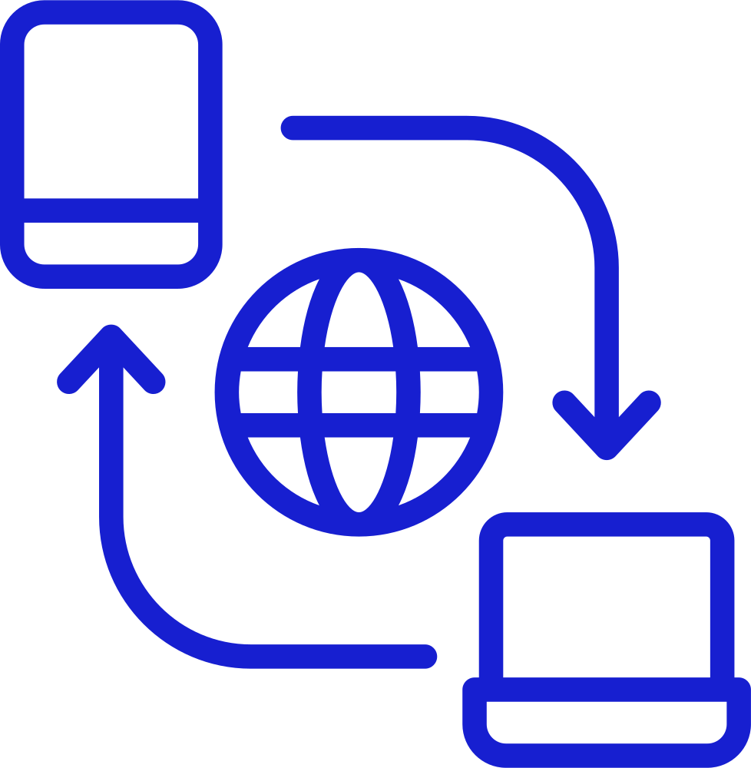





WHEN ?
February
March
April
May
Introduction
Repo Access
Presentation
Project Plan
Slide deck Completion
Risk control
Initiation
Online Meeting w Bram
Internship Completion

Slide 19


Communication
01
02
Used for backlog management, tracking tasks, and project planning.
Facilitates team discussions, meetings, and collaboration planning.

Slide 20
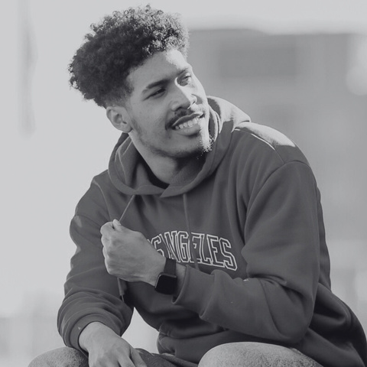
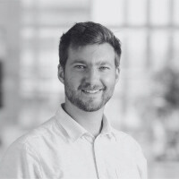
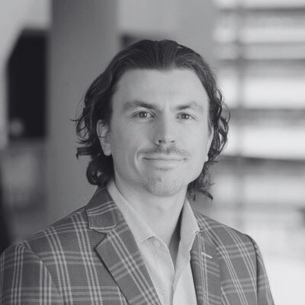
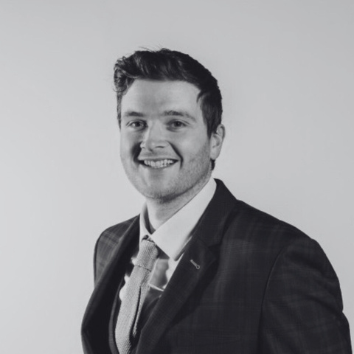
WHO IS WHO ?
Fabrice
Kristof
Jonas
Niels

Slide 21
Thank you !

